Slide 1

Introduction to OS
PASS: good, thorough responses
CS532: OS Foundations
Lab Assignment
email address: parth2@pdx.edu
partner’s email address: N/A

Slide 2
Instructions: Make a copy of this document, move your copy to your submissions folder and fill the document with your responses. Use the space on each slide to show your responses, and add additional slides as needed.
When ready for grading: complete the lab assignment submission form and include a link to your filled document

Slide 3
1. Which operating systems have you used prior to this class? List as many as you can think of.
Answer:- 1) Microsoft Windows
2) Linux (ubuntu)
3) MacOS
4) Android

Slide 4
2. Compile and run the mytest.c program and run three concurrent copies of it as shown in the lecture video. use the "jobs" command to list the running mytest processes, and use the "kill" command to terminate them. Take a screenshot of the result and paste into the follow slide.
Answer:-
For compiling the program, we use the command
gcc -Werror -Wall mytest.c -o mytest
For running three concurrent copies of the same program, we use the command:-
./mytest goodbye & ./mytest farewell & ./mytest so_long &
Jobs command will list running processes and kill with the proper argument will kill the process. The screenshots for the same are in the next slides

Slide 5
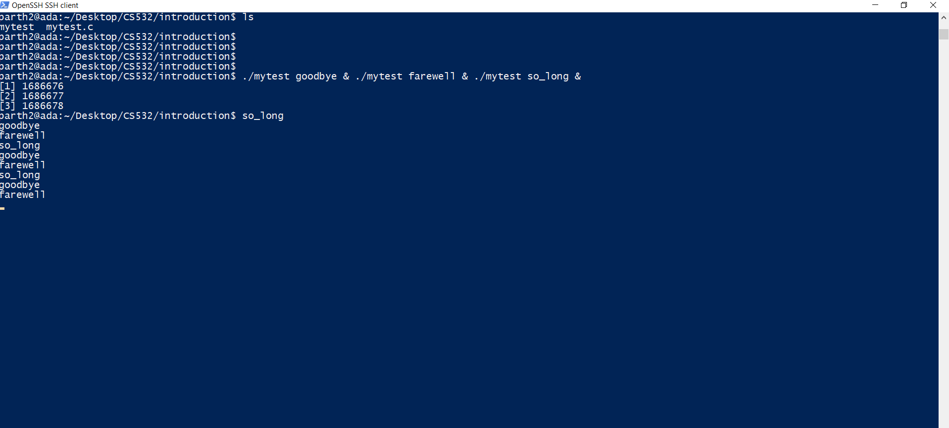
Screenshot(s) for #2
Screenshot for running three concurrent copies of the same process.

Slide 6
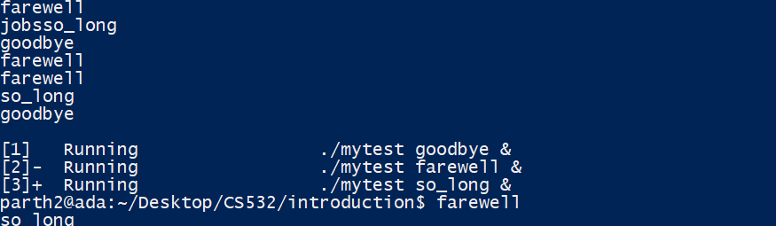
2) Use of Jobs command to list the running mytest processes

Slide 7
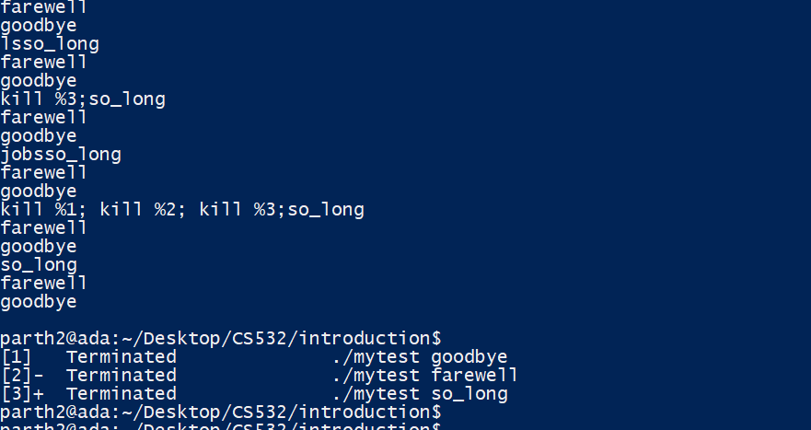
3) Kill command to terminate these processes is executed below:-

Slide 8
3. Compile and run the mytest2.c program as shown in the lecture slides. Run it until it crashes with a "Segmentation Fault". What is a segmentation fault?

Slide 9
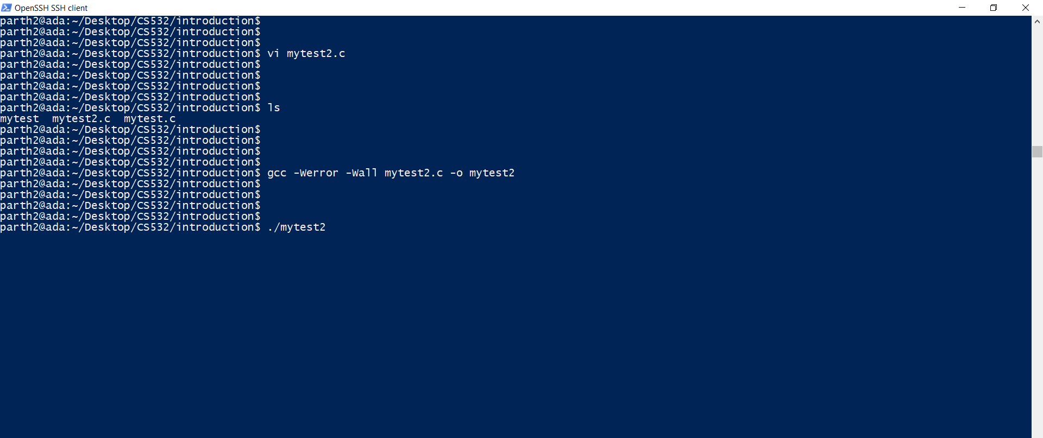
Compilation screen and run command for mytest2.c program

Slide 10
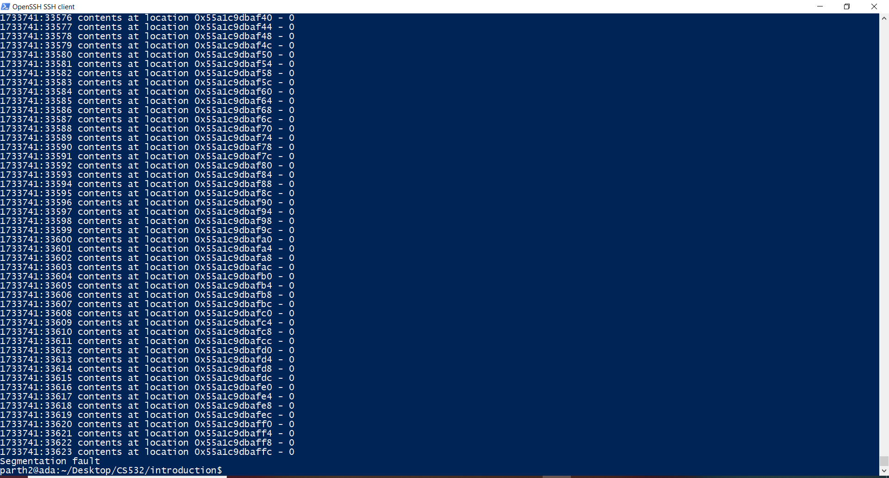
Running the compiled mytest2.c program and segmentation fault screen

Slide 11
Segmentation Fault:-
Segmentation fault is a specific kind of error which occurs when our program tries to access a memory space/ memory which does not belong to the program and has not been allocated to the program by the resource manager.
It normally occurs when a code tries to perform a read or write operation in a read only memory location.
It can also occur when there is a memory corruption due to illegal use of String literals or illegal use of pointers in C/C++.

Slide 12
4. Describe how you might fix the two bugs in the mytest2.c code.
Answer:- 1) The data type assigned here is without knowing the length of the address space. This should be avoided as it can lead to segmentation faults.
2) The loop condition should be checked with respect to memory allocation i.e. break the loop once the memory space allocation for the user process is crossed. Also, we need to check return value of the malloc() function because this can lead to segmentation problems.

Slide 13
5. One of the most useful OS skills you can learn is to trace system calls for a program. On our department's linux servers you can use the "strace" program to trace all of the OS system calls called by a program. Use the strace program to trace all system calls called by the ./mytest2 program. Do it like this: "strace ./mytest2" This command will cause strace to run the ./mytest2 program AND trace all of the system calls called by ./mytest2. Collect the names of all of the system calls listed by strace and the number of times each syscall is called. Then use "man 2 <syscallname>" to get a one line description of each syscall. Record your results in the table on the following slide. Add extra rows/pages as needed.
Answer:- From the next Slide

Slide 14
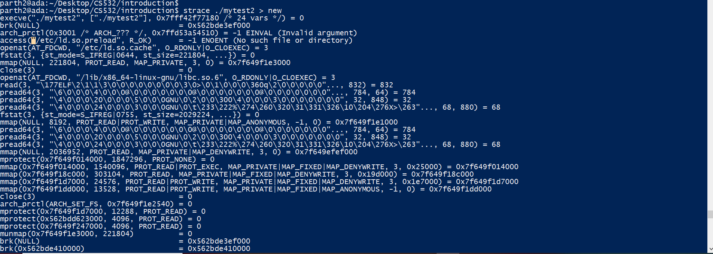

Slide 15
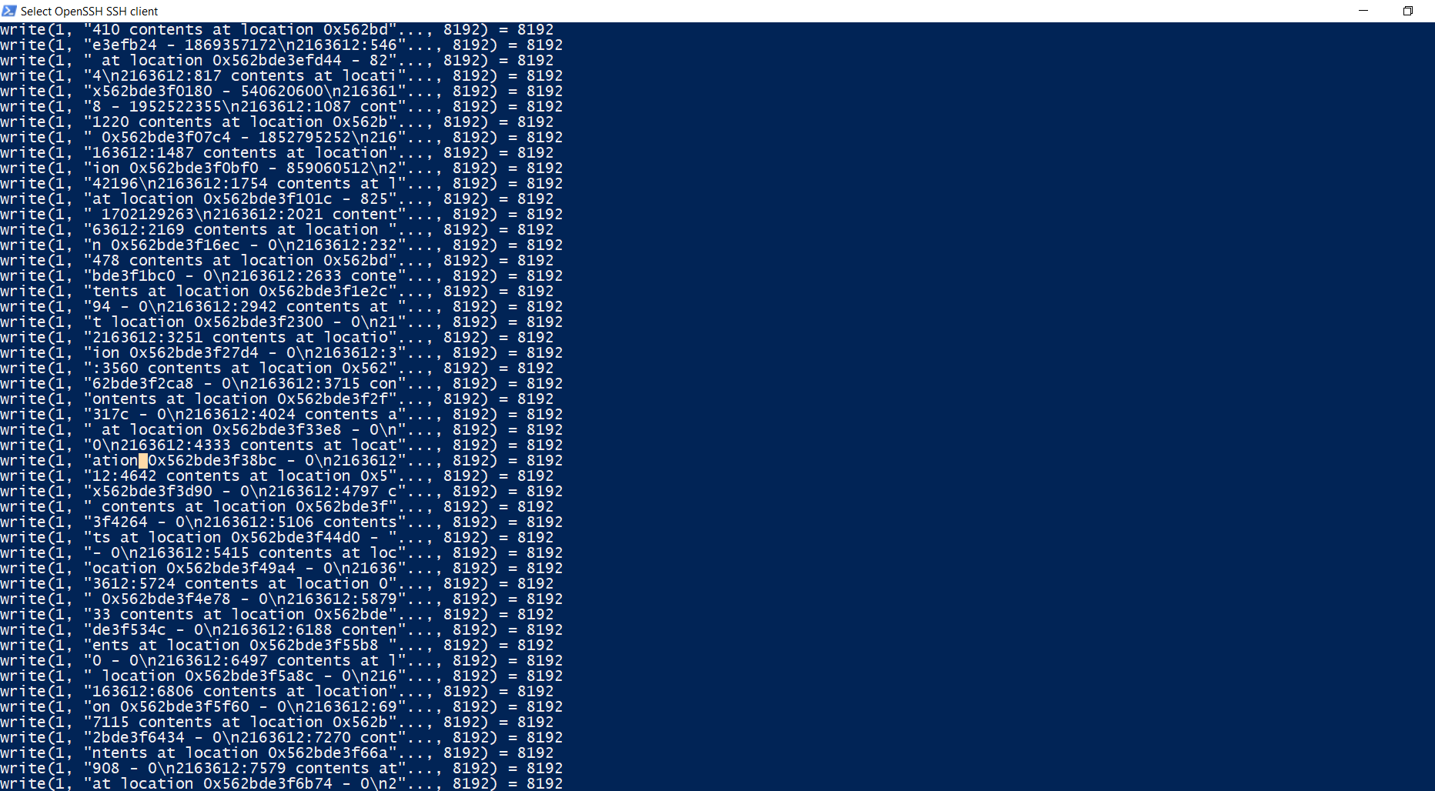

Slide 16
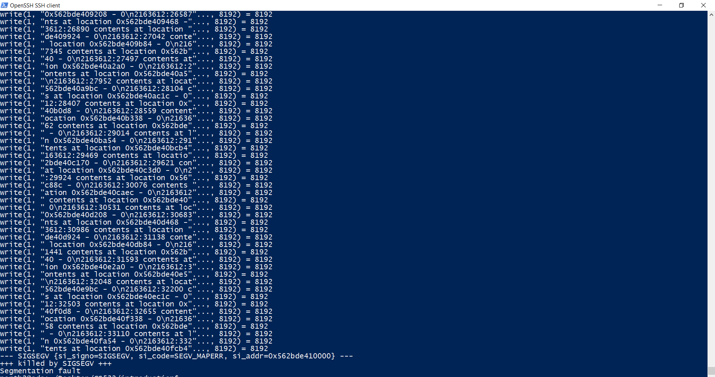

Slide 17
Traced System Calls for #5
syscall name | One line description of this syscall | count
execve | execve() executes the program referred to by pathname. This causes the program that is currently being run by the calling process to be replaced with a new program, with newly initialized stack, heap, and (initialized and uninitialized) data segments. | 1
brk | brk() and sbrk() change the location of the program break, which defines the end of the process's data segment (i.e., the program break is the first location after the end of the uninitialized data segment). Increasing the program break has the effect of allocating memory to the process; decreasing the break deallocates memory. | 3

Slide 18
syscall name | One line description of this syscall | count
arch_prctl | arch_prctl() sets architecture-specific process or thread state. code selects a subfunction and passes argument addr to it; addr is interpreted as either an unsigned long for the "set" operations, or as an unsigned long *, for the "get" operations. | 2
access | access() checks whether the calling process can access the file pathname. If pathname is a symbolic link, it is dereferenced. | 1
openat | The open() system call opens the file specified by pathname. If the specified file does not exist, it may optionally (if O_CREAT is specified in flags) be created by open(). | 2

Slide 19
syscall name | One line description of this syscall | count
fstat | fstatat() retrieve information about the file pointed to by pathname. fstat() is identical to stat(), except that the file about which information is to be retrieved is specified by the file descriptor fd. | 3
mmap | mmap() creates a new mapping in the virtual address space of the calling process. The starting address for the new mapping is specified in addr. The length argument specifies the length of the mapping (which must be greater than 0). | 7

Slide 20
syscall name | One line description of this syscall | count
close | close() closes a file descriptor, so that it no longer refers to any file and may be reused. Any record locks (see fcntl(2)) held on the file it was associated with, and owned by the process, are removed (regardless of the file descriptor that was used to obtain the lock). | 2
read | read() attempts to read up to count bytes from file descriptor fd into the buffer starting at buf. On success, the number of bytes read is returned (zero indicates end of file), and the file position is advanced by this number. | 1
pread64 | pread() reads up to count bytes from file descriptor fd at offset offset (from the start of the file) into the buffer starting at buf. The file offset is not changed. | 6

Slide 21
syscall name | One line description of this syscall | count
mprotect | mprotect() changes the access protections for the calling process's memory pages containing any part of the address range in the interval [addr, addr+len-1]. addr must be aligned to a page boundary. If the calling process tries to access memory in a manner that violates the protections, then the kernel generates a SIGSEGV signal for the process. | 4
getpid | getpid() returns the process ID (PID) of the calling process. (This is often used by routines that generate unique temporary filenames.) | 1
write | write() writes up to count bytes from the buffer starting at buf to the file referred to by the file descriptor fd. | 222

Slide 22
syscall name | One line description of this syscall | count
munmap | munmap() removes any mappings for those entire pages containing any part of the address space of the process starting at addr and continuing for len bytes | 1

